Slide 1
Implementation of LAN using VHDL
Vaibhav Sahu

Slide 2
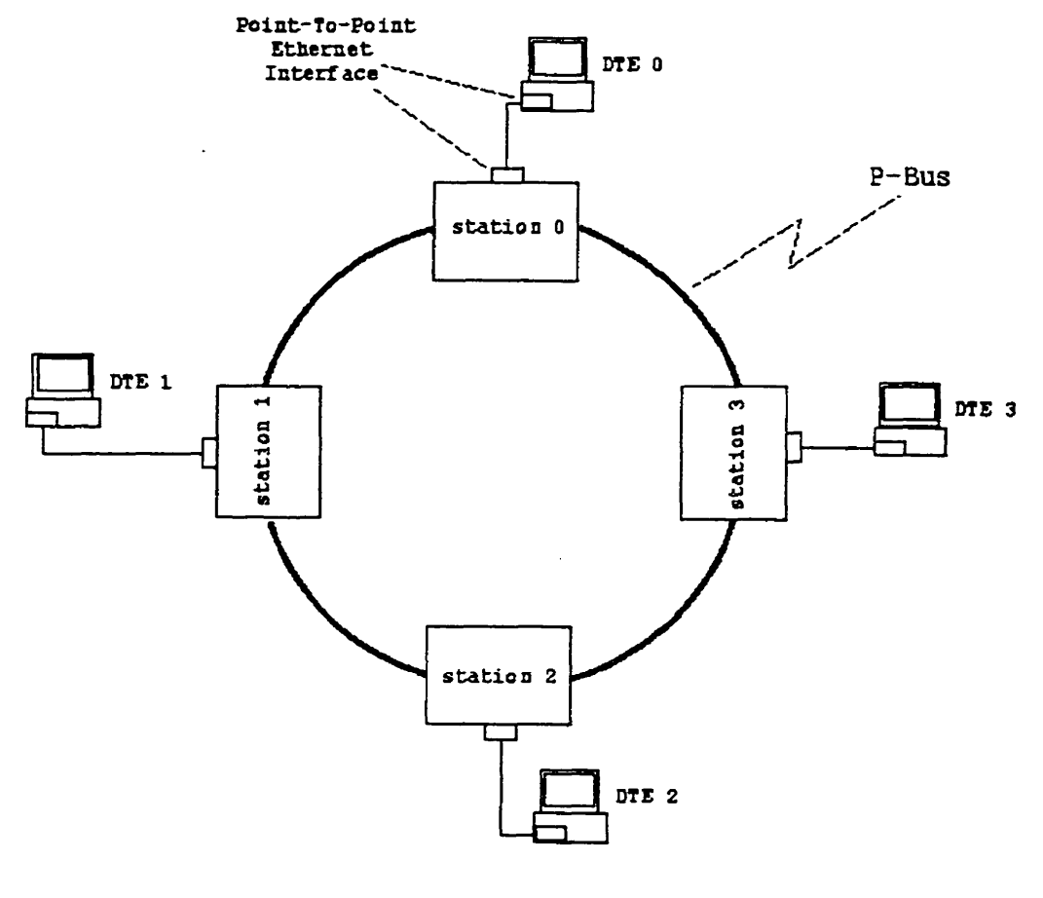
Our Proposed LAN Architecture
The data bus is of the form of the P-Bus
The data bus is a parallel pipelined bus with a width of 33 bits.

Slide 3
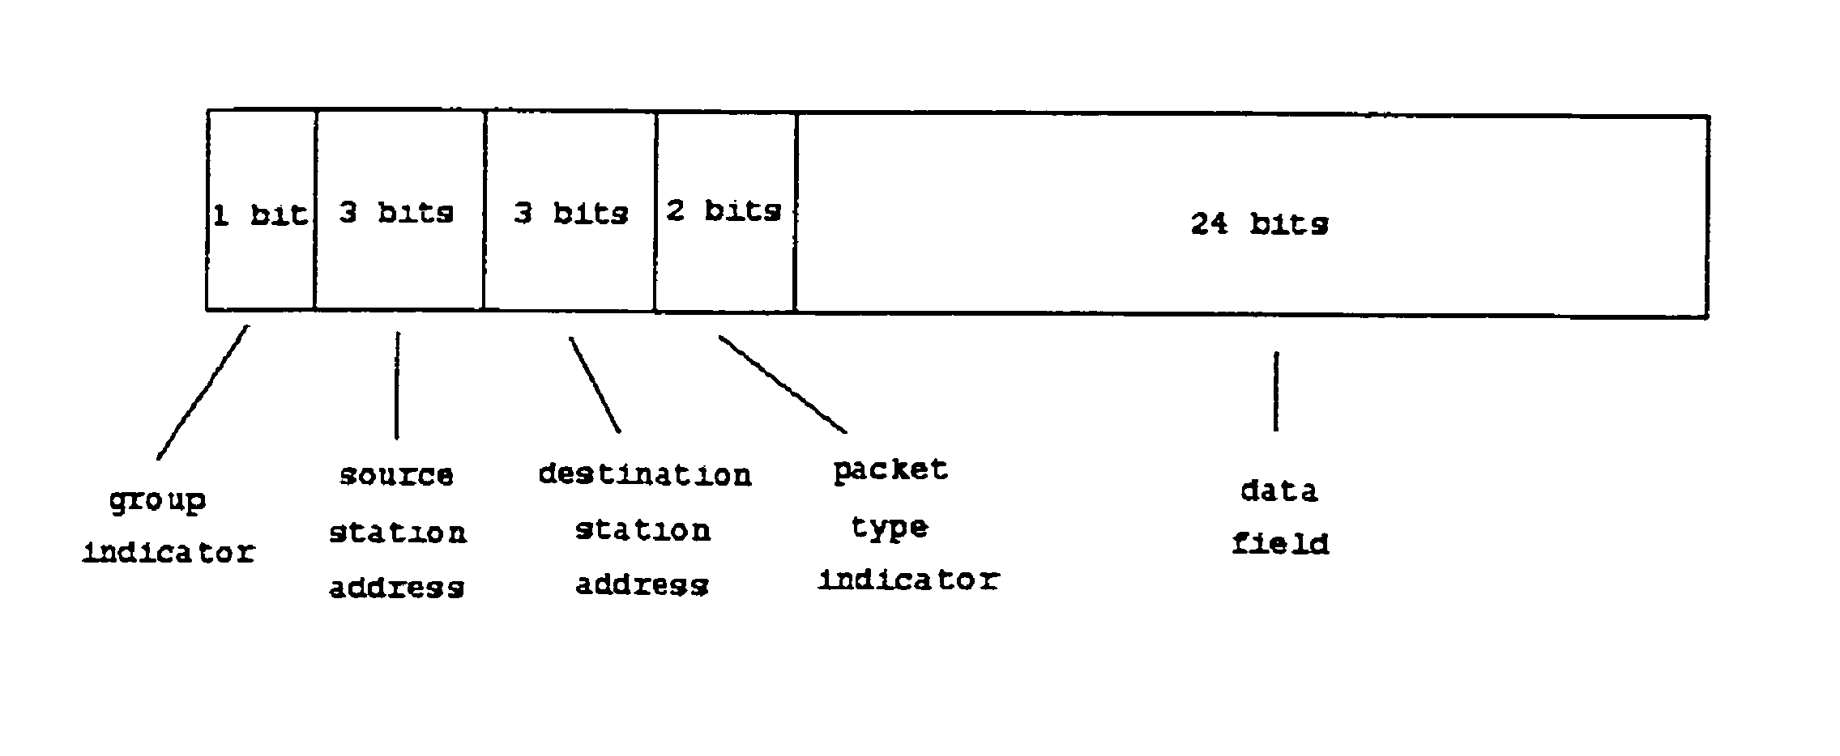
Data Packet Format
33 bits is the standard size of a data packet that is transferred on the ring.

Slide 4
Types of Data Packet
Data packets are of 4 types-
1-real data packet (packet type indicator “ 11“ )
2- Ack packet (packet type indicator “ 10“ )
3- Nack packet (packet type indicator “ 01“ )
4- empty packet (packet type indicator “ 00“ )

Slide 5
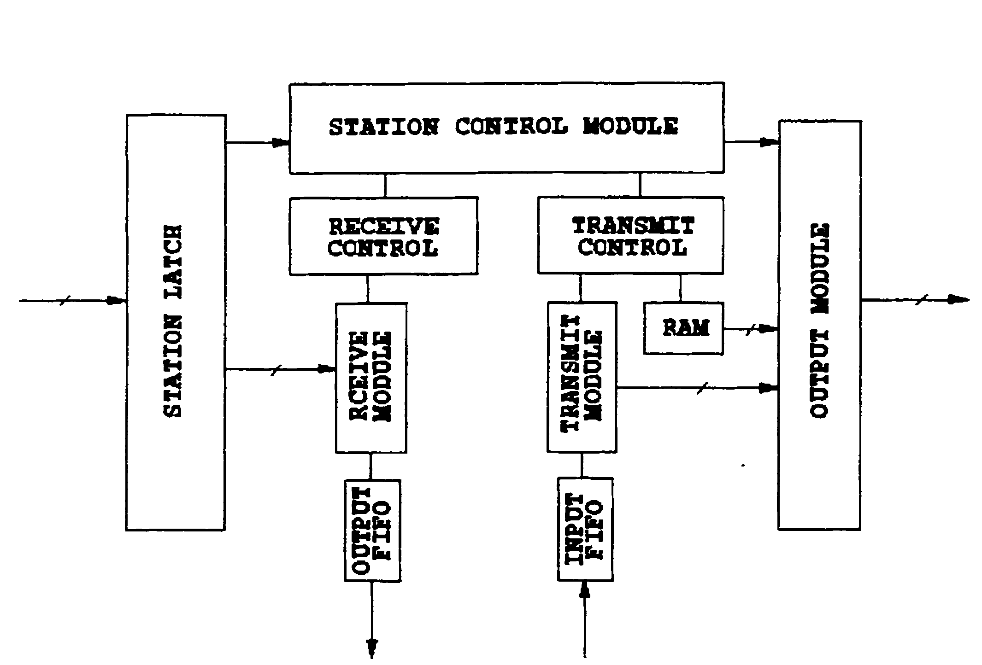
Transcieving station
It has several modules-
1- Station control module
2- Receive module
3- Receive control module
4- Transmit module
5- Transmit control module
6- Output module

Slide 6
Station control Module
Station control module examines the destination address field and the packet type indicator field.
If destination station address doesn’t matches the
station’s address it passes the packet to next station.
If it matches ,it checks packet type indicator field to get the type of the packet

Slide 7
If it is a real data packet it sends receive signal to receive control module.
If it is an empty packet it sends transmit signal to transmit control module.
If it is an Ack packet it sends send-empty signal to the output module.
If it is an Nack packet it sends retransmit signal to the transmit control module.

Slide 8
Receiving Data
After getting receive signal from station control module ,it starts receiving data.
If FIFO buffer becomes full during receiving ,it requests a Nack packet to be sent to source station.
If receives the 24 bit data successfully it requests an ack packet to be sent to source station.

Slide 9
Transmitting Data
The transmit control module performs the following functions :
detects the beginning of an Ethernet packet.
determines the destination station address.
segments the Ethernet data packet into 24 bits segment.
assembles the real data packet that will be transferred
on the data bus.

Slide 10
What we have done?
The implementation of this LAN structure contains 22 modules to code.
We have coded all the modules to work as required.
All the coding has been done on VHDL(very high speed integrated circuits’ hardware description language)

Slide 11
Modules
ack_nack.vhd
bus_clock_generator.vhd
cmmunication_control.vhd
data_shift_component.vhd
five_bit_counter.vhd
input_control_component.vhd
output_control_component.vhd
output_ready_shift_signal_control.vhd
parallel_series_cnverter.vhd
preamble_identifier.vhd
preclear_signal_generator_1.vhd
Preclearsignalgenerator.vhd
receive_signal_control.vhd
sation_latch.vhd
send_signal_control.vhd
series_parallel_converter.vhd
shift_control.vhd
static_RAM.vhd
three_bit_counter.vhd
mac_address_converter.vhd
mac_address_register.vhd
LAN.vhd

Slide 12
Conclusion
LAN on a chip architecture a possible candidate for the future LAN architecture for real-tune applications
because-
1- there was no collision when each transmission
has different destination station.
2- The time delay caused by the collision varies,
but is not random, with the maximum delay.
3- comparing to the Ethernet common data bus architecture,
the LAN on a chip architecture causes less time delay
increase.

Slide 13
THANK YOU

